Slide 1


Slide 2


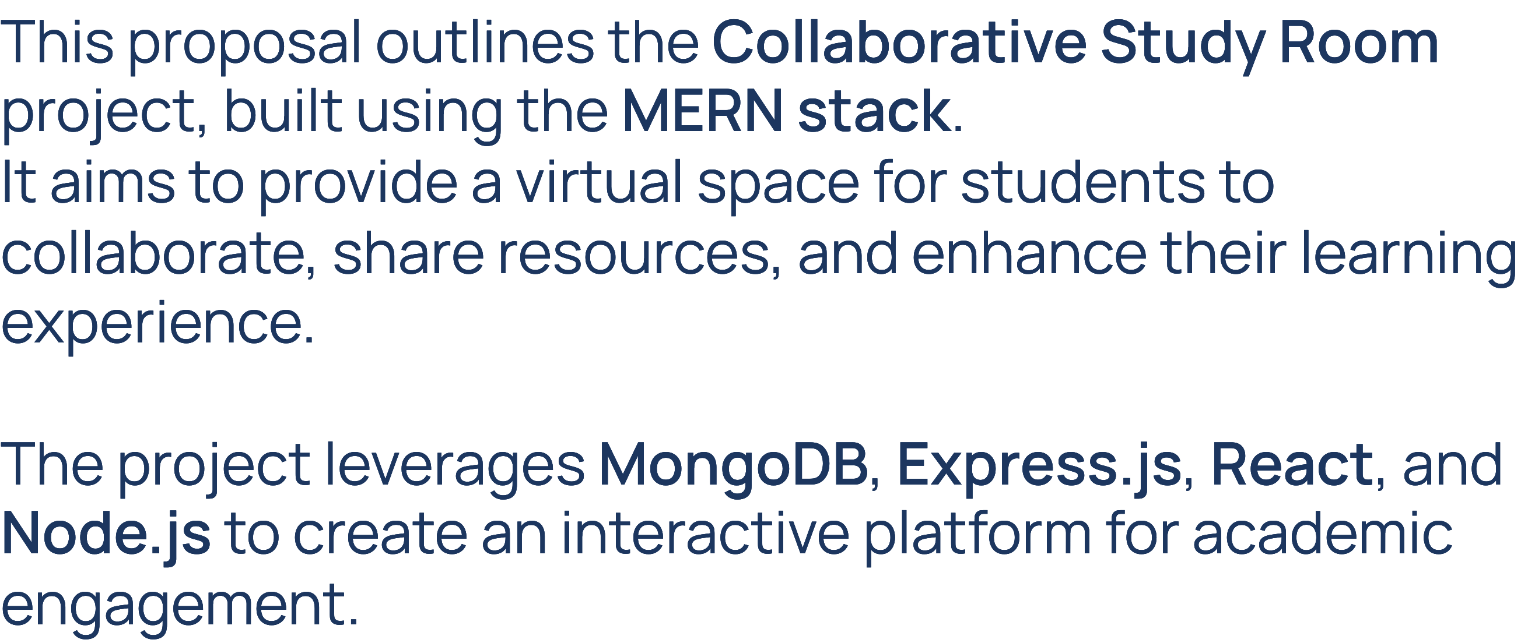

Slide 3

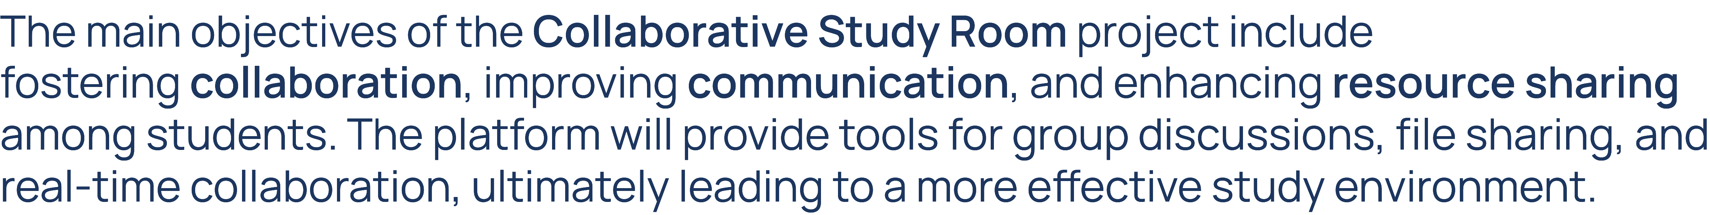

Slide 4




Slide 5


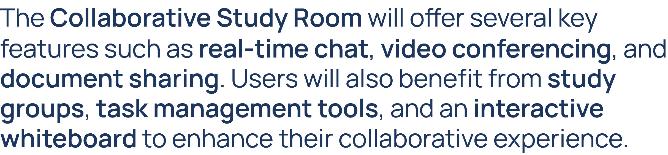

Slide 6


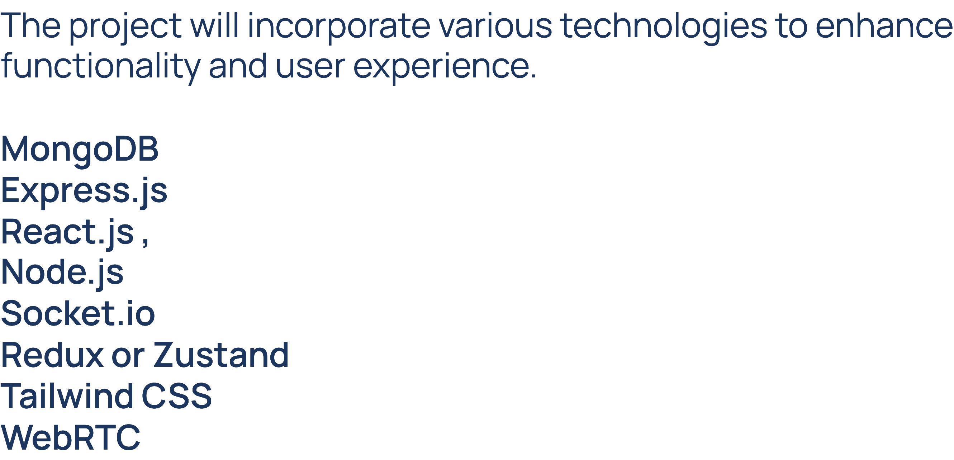

Slide 7



Slide 8

Team Members :
Shivam Sharma (2210ll2316)
Shivam Sharma (2210ll2317)
Shivansh Garg (2210ll2321)
Shivansh Makhija (2210ll2325)

